Slide 1

Time series data analysis and forecast methods
Lecture 3
Time series classification and properties estimation with spectral and statistical methods

Slide 2

Lecture map
Definition of periodogram
Specific character of Nyquist–Shannon sampling theorem in time series data analysis
Spectrum analysis
Statistical hypothesis testing, general algorithm
Some useful statistical tests for time series
Testing the null hypothesis of stationarity

Slide 3
PART 1. SPECTRUM ANALYSIS OF STATIONARY TIME SERIES

Slide 4
Periodogram
Power Spectral Density (PSD) estimation
Fourier transform of sample ACF estimation
PSD = the same estimation, as ACF, but in frequency representation

Slide 5
Periodogram
Modifications and alternatives:
Averaging and window convolutions;
Bartlett’s method of averaged periodograms;
Welch’s method;
Multitaper-method (Thomson's PSD estimate);
And many others…

Slide 6
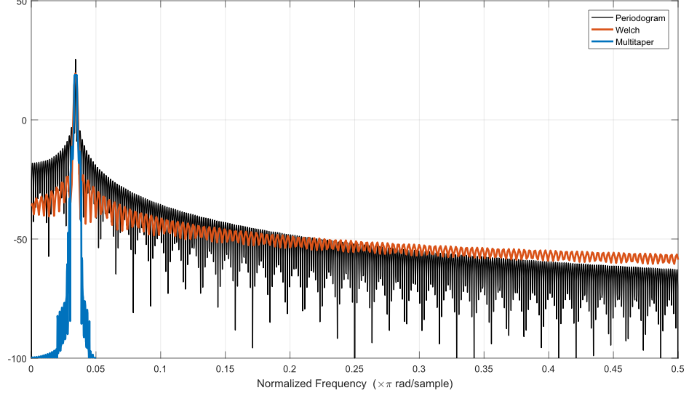

Slide 7
Drawbacks
Spectral leakage
The available time span is finite, thus resulting in distortion of frequency domain;
For example, all delta-functions would be replaced by their sinc-approximations.

Slide 8
Drawbacks
Fixed frequency resolution
The number of points in time series is always finite and determined.
It means that variance at any given frequency does not decrease as the number of samples increases.

Slide 9
PART 2. Nyquist–Shannon sampling theorem

Slide 10
Nyquist–Shannon sampling theorem
Any continuous signal can be reconstructed from its discrete time series unambiguously, only if its spectrum bandwidth is finite and maximum frequency is less (or equal) than Nyquist frequency.
In other words, bandwidth limit must be strictly less than ½ of sample rate.

Slide 11
Nyquist–Shannon sampling theorem
Consequences for time series:
Minimal found period for any cycle or season is greater than 2 of sampling intervals
With fixed frequency resolution problem it also means that it is impossible to separate two components with periods, differing with less or equal minimal period

Slide 12
Summary
ACF estimation and PSD estimation are equivalent in their meaning;
All of these estimations are only defined for stationary (in wide sense) time series;
Is also means, that their frequency or period representations are not a functions of time (as opposed to adaptive methods);
Everything you see in time series can be located in ACF and PSD visual representations

Slide 13
PART 3. Statistical hypothesis testing

Slide 14
Statistical significance
The result is statistically significant, if probability of its random (error) occurrence is close to zero.
In statistical hypothesis testing, statistical significance (or a statistically significant result) is attained whenever the observed p-value of a statistical test is less than the significance level
The p-value is the probability of obtaining results at least as extreme as those observed

Slide 15
Statistical hypothesis
A stochastic assumption about the distribution and properties of some stochastic variable, that can be accepted or rejected by statistical tests
In other words, a hypothesis that is testable on the basis of observing a process that is modeled via a set of random variables or a time series data
Statistical hypothesis always has only two kind of answers: “accept” or “reject”.

Slide 16
Statistical hypothesis
Two rival hypotheses:
Null Hypothesis H₀
Alternative Hypothesis H₁
Accepting the null hypothesis is the same as rejecting the alternative hypothesis, and vice versa

Slide 17
Statistical hypothesis
Single hypothesis
allows to unambiguously define the distribution and its properties for the analyzed stochastic variable
Complex hypothesis
allows to define only a belonging to the family of distributions, thus complex hypothesis consists of several single hypotheses

Slide 18
Statistical Test
Checks the hypothesis with the test statistic estimation by some kind of calculation process
Test statistic or criteria – quantitative measure, derived from a sample, that allows to distinguish the discrepancy between the null hypothesis and its alternative

Slide 19
Statistical criteria
Parametric
Estimate the statistical parameters of initial time series data
Non-parametric
Using only samples of time series data without parameters estimation

Slide 20
Statistical tests errors
Type I
the incorrect rejection of a true null hypothesis, i.e. false positive
Type II
the incorrect acceptance of a false null hypothesis, i.e. false negative

Slide 21
Statistical tests errors
Type I
Detecting the effect that is not present
Type II
Failing to detect an effect that is present
The probability of a type I error is called significance level α and is the main factor for the statistical tests

Slide 22
Statistical Test
State the relevant null hypothesis and, opposite to it, alternative hypothesis
Select a significance level α, a probability threshold below which the null hypothesis will be rejected
Estimate from initial time series data the relevant statistical criterion k – the stochastic variable, which should be a value from a desired probability distribution

Slide 23
Statistical Test
Compare the estimated criterion with the a priori known statistical critical criterion value
Check the estimated criterion if its within some critical region
Decide to either reject the null hypothesis in favor of the alternative or accept it.
The decision rule is to reject the null hypothesis H₀ if the estimated criterion is in the critical region, and to accept or “fail to reject” the hypothesis otherwise

Slide 24
Simple version of test
Compute the statistical criterion based on hypothesis and significance level α
Calculate the p-value. This is the probability of sampling a criterion at least as extreme as that which was observed in time series
Reject the null hypothesis, in favor of the accepting alternative hypothesis, if and only if the p-value is less than the significance level threshold.

Slide 25
PART 4. Statistical hypothesis testing AND CRITERIA FOR TIME SERIES

Slide 26
Useful tests
Anomaly observations test (Irvine test)
Student’s t-test
Two-sample F-test for equality of variances
Run test, based on median value
Check for time series stationarity:
based on t-test + F-test
ADF-test
KPSS-test

Slide 27
Anomaly observations test
Irvine method
Null hypothesis
i-observation is not an anomaly
Alternative hypothesis
i-observation is an anomaly

Slide 28
Anomaly observations test
Estimate the criterion:
Where value:
If , than with the probability α the null hypothesis would be rejected,
i.e. this i-observation is an anomaly.

Slide 29
Critical criteria table
N
10 | 1.5 | 2.0
20 | 1.3 | 1.8
50 | 1.1 | 1.6
100 | 1.0 | 1.5
400 | 0.9 | 1.3

Slide 30
Example
Time series data:
100, 143, 124, 115, 113, 110, 105, 100, 104, 105
With we need criterion k > 1.5;
Estimate the k_{i} for every observation
Observations 2 & 3 reject the null hypothesis, i.e. they are anomalous

Slide 31
Student’s t-test
Test for a constant expectation value (no trends, data follows the normal distribution)
Test that the means of two samples are equal
Null hypothesis:
Alternative hypothesis:

Slide 32
Student’s t-test
Separate the initial time series data into two equally-sized samples:
Estimate the t-test criterion:

Slide 33
Student’s t-test
If it is true, that
where - is a value from the Student distribution, than the null hypothesis about two equal expectation means is rejected on the significance level α
It means that the expectation mean is not constant and in time series there are some deterministic (non-stochastic) components (trends, cycles, etc.)

Slide 34
Student’s t-test
Initial substantial assumption for the test:
How to verify this assumption?
Of course we need to test this assumption as a null hypothesis with some statistical test

Slide 35
F-test
Two-sample F-test for equality of variances
Initial assumptions: normal distribution and two samples are from the same variable
Null hypothesis:
Alternative hypothesis:

Slide 36
F-test
Fisher (F) criterion:
If inequality below is false,
than the null hypothesis about the equality of variances is rejected with significance level α

Slide 37
Run test
Rearrange the initial time series data into variational time series in ascending order
Estimate the sample median value:

Slide 38
Run test
Shape the run of «+» and «–»
«+», if
«–», if
If , than disregard these points
If the initial time series consists of independent observations, than the alternation between «+» and «–» is random, i.e. their numbers are approximately equal and the sequence lengths are almost the same throughout the run

Slide 39
Run test
Even if one of these two inequalities is false,
than the null hypothesis is rejected
It means that alternative hypothesis about non-random (deterministic, non-stochastic) component in the time series is accepted

Slide 40
PART 5. Testing the null hypothesis for stationarity

Slide 41
Time Series Stationarity
The faithful theoretical stationarity definition (in narrow and wide senses) is non-applicable
The approximation to this definition:
State the null hypothesis of time-independent expectation mean value and variance
(only wide sense stationarity)
It means that on all sub-intervals of time span the mean and variance values are equal

Slide 42
Time Series Stationarity
Divide the initial data into equal time spans;
Test these samples with F-test and t-test in pairs;
Even if one of those tests failed
– time series is non-stationary.
This technique is ill-conditioned, because the F-test and t-test are based on normal distribution

Slide 43
KPSS-test
Kwiatkowski–Phillips–Schmidt–Shin Test
Let the model for time series be defined as
Null hypothesis:
time series data is stationary and
Alternative hypothesis:
time series data is non-stationary and

Slide 44
KPSS-test
Calculate the criterion:
Compare it with critical criterion;
Accept or reject the null hypothesis about time series stationarity;
In practice KPSS-test is already programmed and gives you the answer at once.

Slide 45
KPSS-test
Basis for the KPSS-test:
an observable time series is stationary around a deterministic trend (i.e. trend-stationary) against the alternative of a unit root
If any ARIMA model has characteristic roots larger than 1 – than the initial stochastic process is non-stationary
If any ARIMA model has several unit roots (= 1) – than the stationarity is still possible in form of ARMA model based on difference scheme

Slide 46
PART 6. QUALITY AND goodness of fit TESTS FOR TIME SERIES

Slide 47
Z-test
The model is of a good quality, when its residual time series is a stochastic variable sample from normal distribution with zero mean (thus, zero-test)
Estimate the residual (error) data:
The good-quality model has zero mean value
Null hypothesis:
Alternative hypothesis:
Estimate the criterion:
If this criterion is bigger than critical value – null hypothesis is rejected, the model is of a poor quality.

Slide 48
Absence of pattern in residual
Rotation points criterion
The point is a rotation point, when
If residual data is random, then one rotational point on average is within 1.5 other points
If there are rotational points, then
If inequality is true:
then the residual data has an absence of pattern

Slide 49
Goodness of fit tests
Chi-squared test for goodness of fit;
KS-test (Kolmogorov-Smirnov test) is a non-parametric test of a complex hypothesis that the empirical sample is drawn from the reference estimated distribution
In our case: in order to check, if the residual data is a sample from normal distribution with unknown parameters.

Slide 50
References
Katsuo Tanaka. Time Series Analysis: Nonstationary and Noninvertible Distribution Theory. — Wiley Series in Probability and Statistics, 2nd ed. — 2016. — 960 p.
Kwiatkowski D., Phillips P. B., Schmidt P., Shin Y. Testing the null hypothesis of stationarity against the alternative of a unit root // Journal of Econometrics, 1992. — Vol. 54. — pp. 159–178.
Dickey D. A., Fuller W. A. Distribution of the Estimators for Autoregressive Time Series With a Unit Root // Journal of the American Stat. Association, 1979. — Vol. 74. — pp. 427–431.
Daniel, Wayne W. (1990). Kolmogorov–Smirnov one-sample test. Applied Nonparametric Statistics (2nd ed.). Boston: PWS-Kent. pp. 319–330. ISBN 0-534-91976-6.

